Slide 1

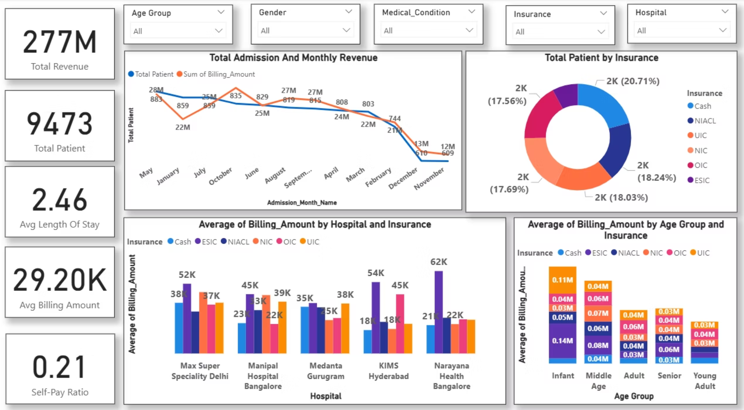
Healthcare Analytics Dashboard
KPI Insight
Strategic insights and actionable recommendations to optimize hospital operations, revenue, and patient care delivery.
The dashboard screenshot above illustrates key performance indicators, providing a visual representation of critical metrics such as patient flow, resource utilization, and financial performance. These metrics enable data-driven decision-making to enhance operational efficiency and patient outcomes.
Aamir Sohail

Slide 2
Detailed Analytics Overview
KPI Insight
These detailed breakdowns provide deeper insights into patient demographics, treatment patterns, and financial performance across different medical conditions and provider specialties.
277M
9,473
2.46
29.20K
Total Revenue
Total Patients
Avg LOS (Days)
Avg Billing Amount
Total revenue generated
Total patient volume served
Low overall average stay; efficiency is high
Average revenue per patient
0.21
Self-Pay Ratio
Only 21% of billing is self-pay (Cash), indicating high reliance on insurance

Slide 3
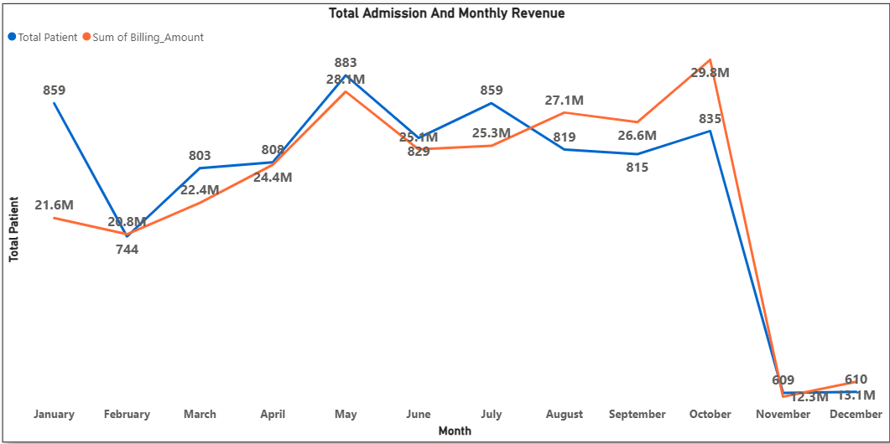
Total Admission and Monthly Revenue Analysis
Key Insights:
Patient admissions and revenue peaked in October (835 patients, 29.8M).
Both metrics then crashed severely, with revenue dropping by 59% to 12.3M and patient count falling to 609 in November.
Action Required:
Conduct an immediate, high-priority analysis to pinpoint the exact operational or market reasons for the drastic decline in November/December.
Implement urgent, targeted marketing and patient acquisition/retention strategies to stabilize the volume and revenue run rate immediately.

Slide 4
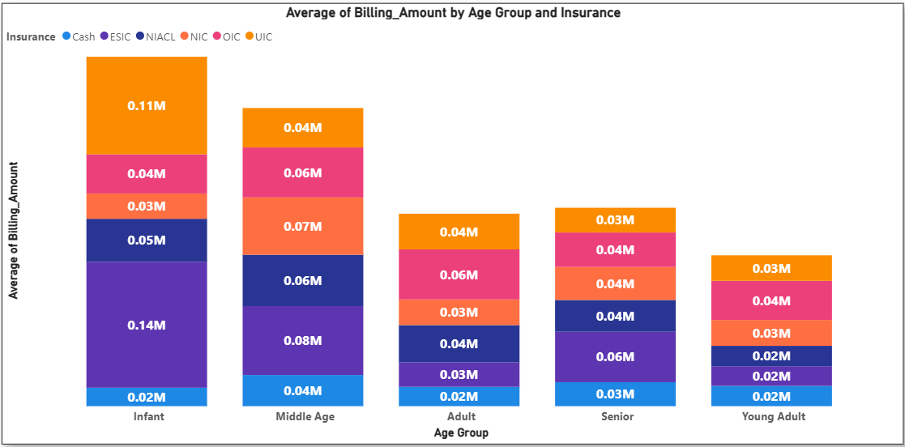

Insurance & Age: Revenue Breakdown
Infant Group
Highest average bill: 0.39M total
NIACL contributes 0.14M
Young Adult
Lowest billing segment
Requires revenue optimization
Action: Streamline claims processing for NIACL Infant patients to protect this critical revenue stream, and seek ways to increase low-value Young Adult billing.

Slide 5
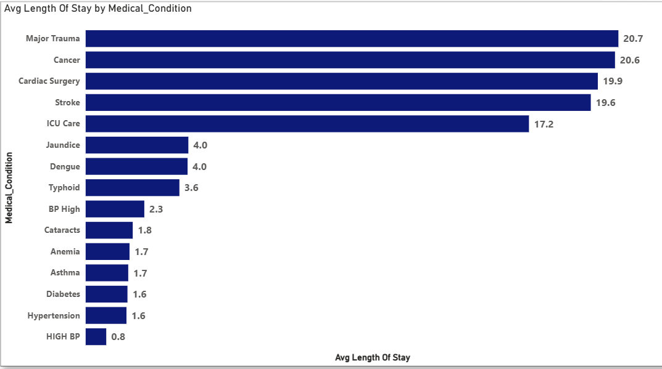
Length of Stay Crisis
Critical Finding
20+
Major Trauma, Cancer, and Cardiac Surgery patients stay 20+ days — five times longer than common conditions.
Days Average
Action Required: Implement proactive discharge planning at admission for high-LOS conditions to optimize bed utilization.
High-risk conditions
5x
Longer
Than common cases

Slide 6

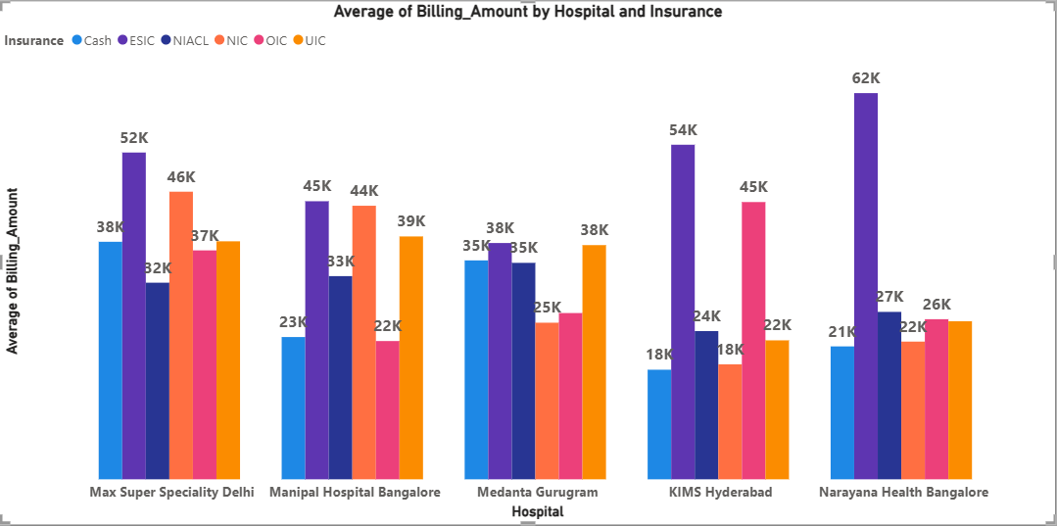
Narayana Health: Revenue Leader
Strategic Opportunity
Analyze Narayana's high-bill strategies to replicate revenue success in other hospitals, particularly for insured patients.
62K
Average Bill
Highest among all hospitals
Narayana Health achieves the highest average billing, primarily driven by NIACL patients.

Slide 7
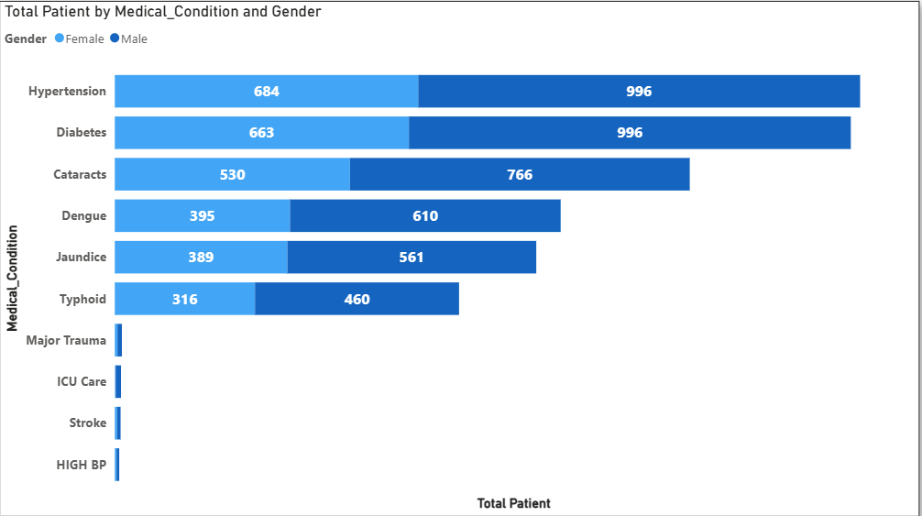
Gender Gap in Patient Volume
Male Dominance
Significantly higher volume across top six conditions
Female Underrepresentation
Lower patient numbers in Hypertension, Diabetes, and other key conditions
Action Required: Implement targeted health screening campaigns for women to ensure early detection and equitable care for the female population.

Slide 8
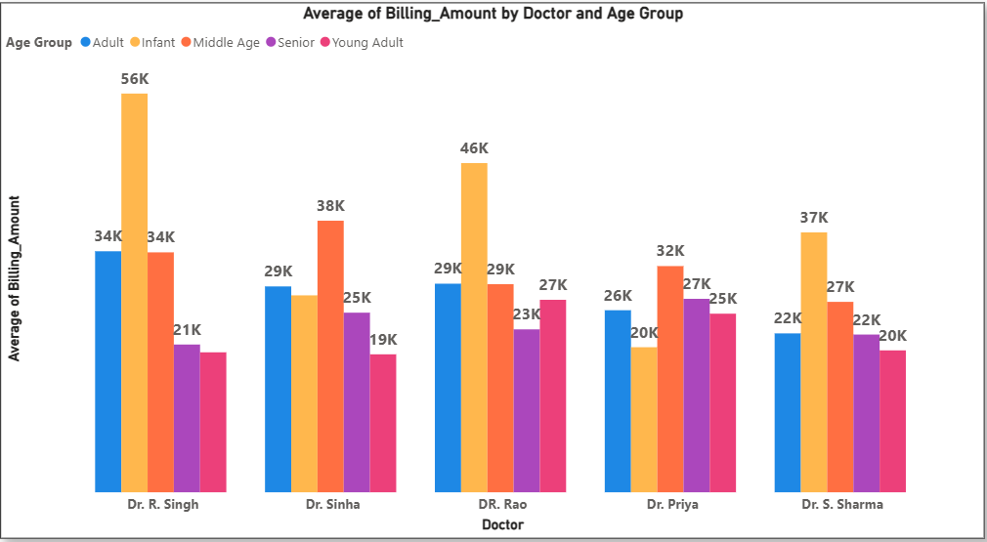
Age Group Billing Patterns
Infant Care: Highest Revenue
Infants consistently yield the highest average billing across all doctors, with Dr. R. Singh reaching 56K per case.
Opportunity Gap
Adult and Young Adult segments show significantly lower billing amounts.
Strategic Action: Develop specialized, high-value packages for Adult and Young Adult segments to boost revenue.

Slide 9
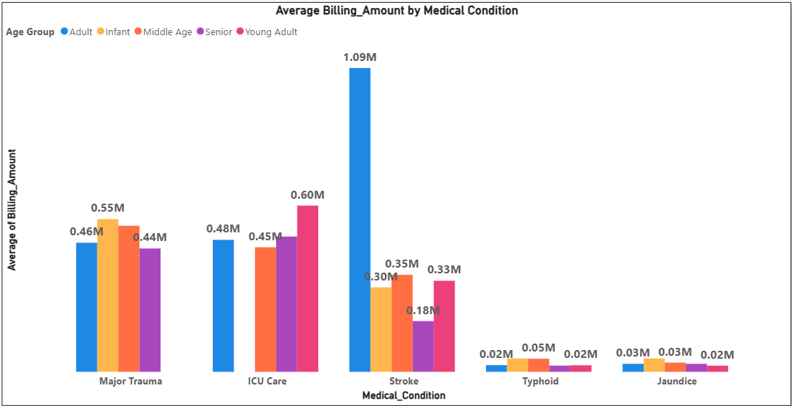
Adult Stroke: Cost Anomaly
1.09M
Adult Stroke patients drive an exceptionally high average bill — three times higher than any other age group for that condition.
Identify
Optimize
Review treatment protocols
Maintain care quality
1
2
3
Analyze
Find cost inefficiencies

Slide 10
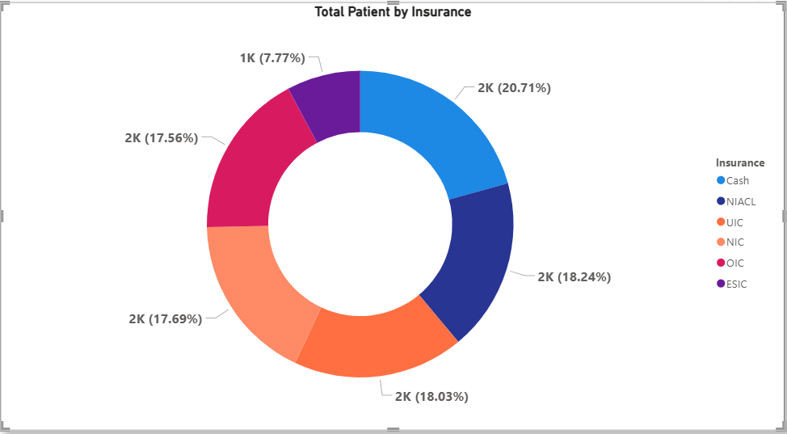
Insurance Payer Distribution
Cash, NIACL, UIC, and OIC represent over 74% of total patient volume, showing highly balanced distribution.
Strategic Focus: Maintain strong operational efficiency with top four payers while seeking opportunities to increase ESIC segment volume.

Slide 11
Key Takeaways & Next Steps
01
02
03
Address Revenue Crisis
Optimize High-LOS Conditions
Replicate Success Models
Investigate sharp decline from 29.8M to 12.3M and stabilize operations immediately
Apply Narayana Health's 62K billing strategies across network
Implement proactive discharge planning for 20+ day stays
04
05
Close Gender Gap
Develop Revenue Packages
Launch targeted screening campaigns for female patients
Create high-value offerings for Adult and Young Adult segments

